Slide 1

REAL TIME VISUALIZATION OF STOCK MARKET PREDICTION
Team Members:
ALBERT PRAVEEN R - 722821104010
DEEPAK RAJAN R - 722821104033
JEEVANANTH P - 722821104063
AJAY SELVAKUMAR C R - 722821104301
Guided By:
MS.J.KEERTHIKA,M.E,(Ph.D.), Assistant Professor,
Dept. of CSE

Slide 2
OUTLINE
ABSTRACT
INTRODUCTION
OBJECTIVE OF THE SYSTEM
EXISTING SCENARIO
PROPOSED SOLUTION
PROJECT MODULES
OVERALL DESIGN EXPERIMENTAL RESULTS
PERFORMANCE EVALUATION
CONTRIBUTION OF THE PROJECT
FUTURE ENHANCEMENTS
REFERENCES

Slide 3
ABSTRACT
The stock prediction system utilizes advanced deep learning models like LSTM and CNN, combined with dimensionality reduction techniques such as PCA, to process historical and real-time financial data for trend forecasting.
By integrating real-time data streams and visualization tools, the platform offers an interactive and scalable interface, enabling users to analyze stock market patterns and access predictive insights dynamically.
The system leverages innovative machine learning strategies, including transfer learning and ensemble methods, to adapt to evolving market conditions, laying the groundwork for future integration of sentiment analysis and external economic factors.

Slide 4
INTRODUCTION
Stock market data is inherently complex and dynamic, posing challenges for investors to interpret and predict trends effectively.
This project presents a Stock Prediction System leveraging cutting-edge machine learning techniques to analyze historical and real-time data, providing clear and actionable insights into market trends.
The system integrates user-friendly visualization tools and adaptive models, facilitating informed decision-making while setting a foundation for future enhancements like sentiment analysis and economic data integration.
Key Technologies: LSTM,CNN,PCA,Streamlit.

Slide 5
OBJECTIVE OF THE SYSTEM
Simplify complex stock market data for better investor understanding.
Generate concise stock predictions from historical and real-time financial data.
Enhance decision-making efficiency for investors by providing actionable insights.
Integrate relevant market knowledge to ensure contextually accurate stock forecasts.

Slide 6
EXISTING SCENARIO
Current Challenges:
Difficulty in interpreting complex stock market data for investors.
Lack of efficient prediction tools for analyzing diverse financial data sources.
Limited integration of external economic factors in stock predictions.
Inefficient manual analysis, leading to time-consuming decision-making processes.

Slide 7
PROPOSED SOLUTION
Utilize ML models like LSTM and CNN to generate accurate, concise stock predictions from complex financial data.
Integrate data processing techniques like PCA and real-time data streams to handle both historical and live market data efficiently.
Key Benefits:
Enhances investor understanding of stock market trends.
Reduces time and effort for investors in analyzing complex financial data.
Ensures accurate and contextually relevant stock predictions for informed decision-making.

Slide 8
PROJECT MODULES
Module 1: Data Acquisition Module
Handles diverse financial data formats (e.g., CSV, APIs) and processes stock market data for analysis.
Module 2: Prediction Module
Utilizes deep learning models (e.g., LSTM, CNN) for generating accurate and context-aware stock market predictions.

Slide 9
PROJECT MODULES
Module 3: Visualization Module
Provides an interactive user interface for visualizing stock predictions and trends, with customizable settings for analysis and output.
Module 4: Data Management Module
Handles efficient storage, retrieval, and management of financial data, ensuring smooth operation and easy access for analysis and predictions.

Slide 10
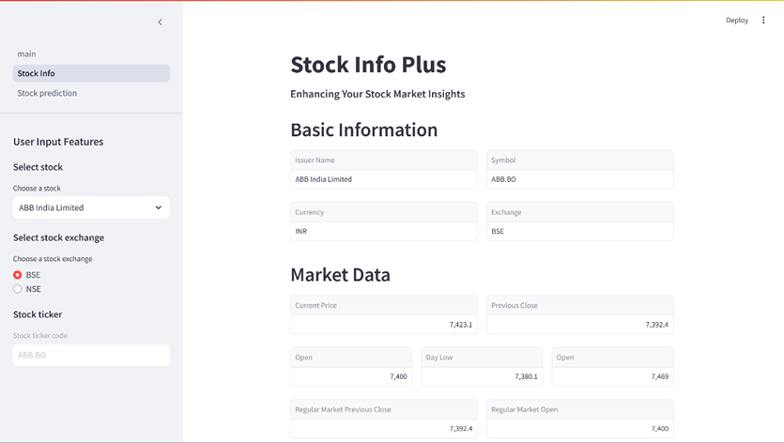
OVERALL DESIGN EXPERIMENTAL RESULTS

Slide 11
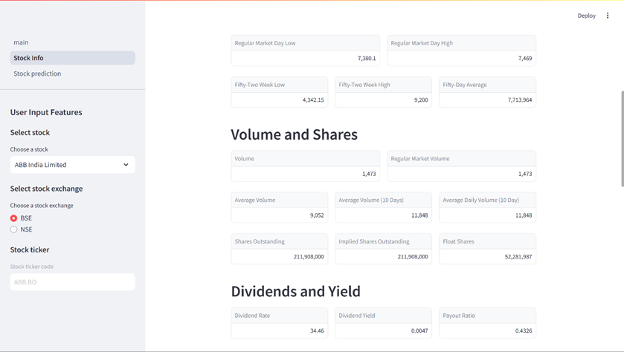
OVERALL DESIGN EXPERIMENTAL RESULTS

Slide 12
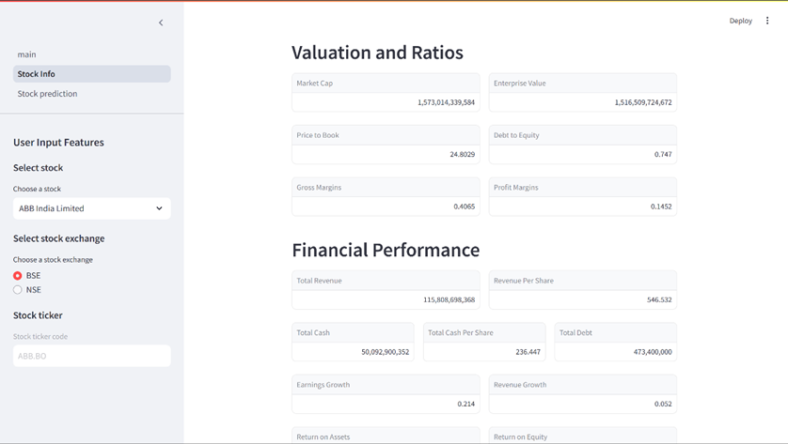
OVERALL DESIGN EXPERIMENTAL RESULTS

Slide 13
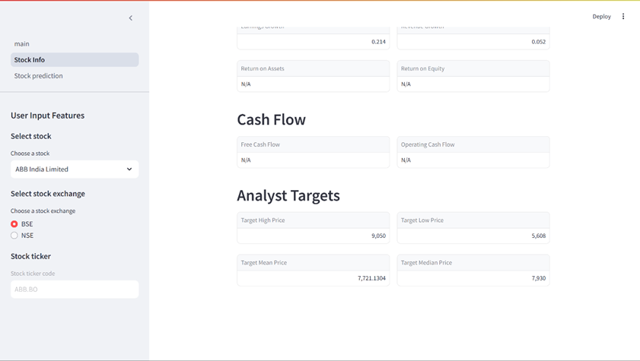
OVERALL DESIGN EXPERIMENTAL RESULTS

Slide 14
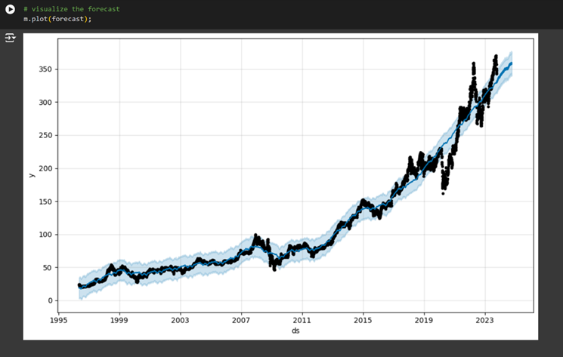
OVERALL DESIGN EXPERIMENTAL RESULTS

Slide 15
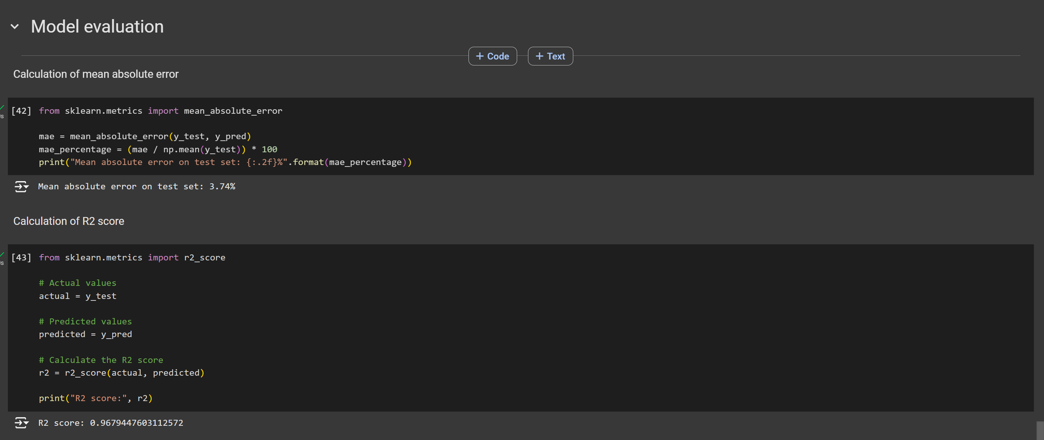
PERFORMANCE EVALUATION

Slide 16
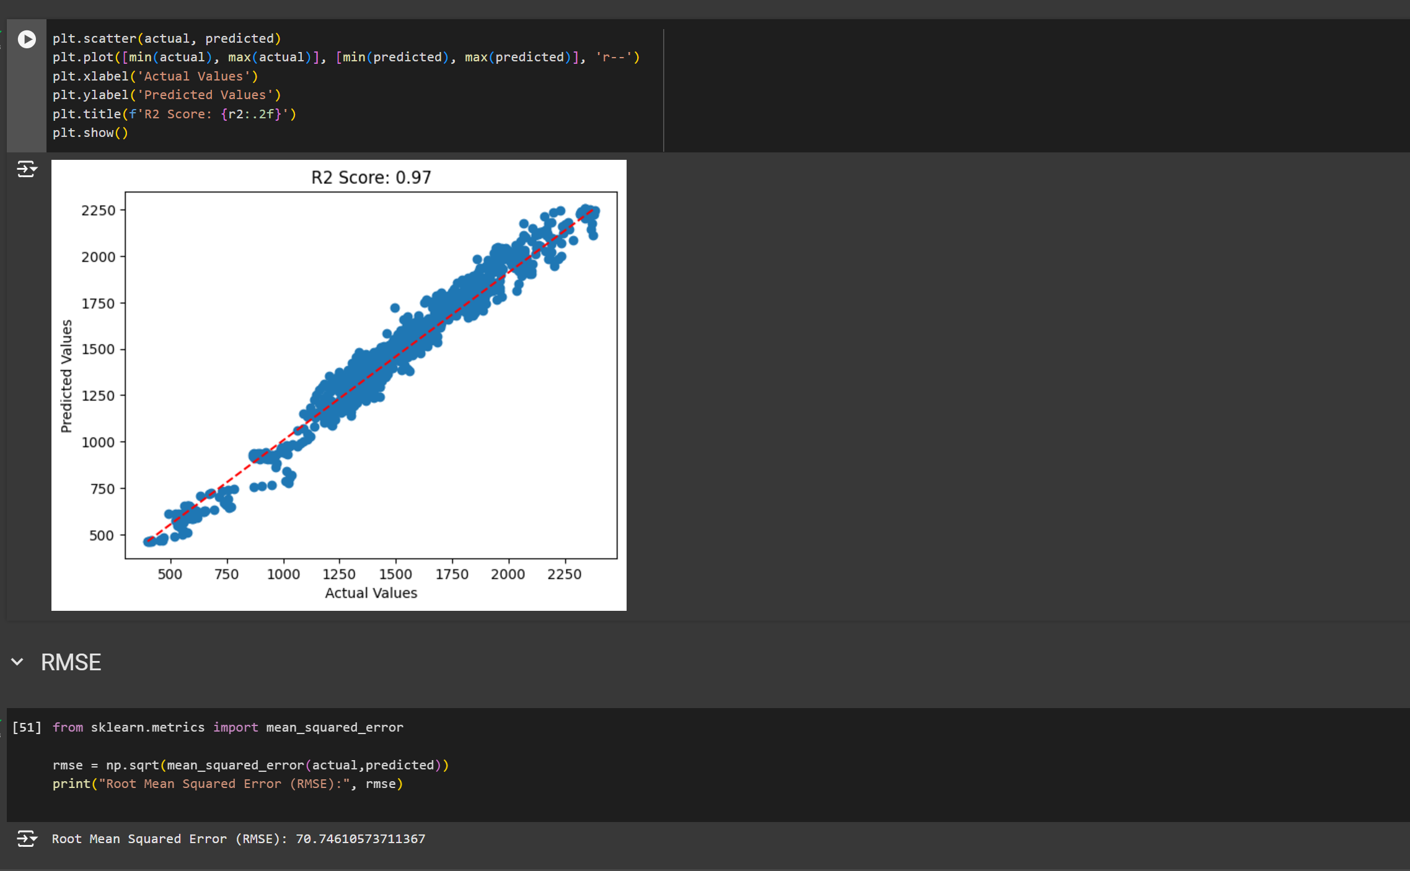
PERFORMANCE EVALUATION

Slide 17
CONTRIBUTION OF THE PROJECT
Provides investors and traders with accurate stock price predictions, enabling informed decisions to optimize returns and minimize risks.
Offers dynamic and real-time forecasting, helping users respond promptly to market changes and capitalize on opportunities.
Reduces complexity for users by presenting key market trends and predictions through user-friendly dashboards and visualizations.
Assists in identifying potential risks in volatile markets, enabling users to take proactive measures to safeguard investments.
Democratizes access to advanced prediction tools, making stock market analysis easier for individual investors and small-scale traders.

Slide 18
FUTURE ENHANCEMENTS
Integration with Financial Data Platforms: Future versions could directly integrate with stock market platforms to automate the prediction and analysis of stock performance and trends.
Multilingual Support: Expanding the system to support multiple languages, making it accessible to a broader range of investors and financial analysts.
Improved Contextual Understanding: Enhancing the system’s ability to understand complex financial contexts, such as market trends and economic indicators, for more accurate predictions.
Personalized Predictions: Incorporating user preferences and historical data to generate personalized stock predictions tailored to individual investment strategies.

Slide 19
REFERENCES
A.N. Arya, Y.L. Xu, L. Stankovic, and D.P. Mandic, "Hierarchical graph learning for stock market prediction via a domain-aware graph pooling operator," ICASSP 2023-2023 IEEE International Conference on Acoustics Speech and Signal Processing (ICASSP), pp. 1-5, June 2023.
J. Choi, S. Yoo, X. Zhou, and Y. Kim, "Hybrid information mixing module for stock movement prediction," IEEE Access, vol. 11, pp. 28781-28790, 2023.
Y. Zhao and G. Yang, "Deep Learning-based Integrated Framework for stock price movement prediction," Applied Soft Computing, vol. 133, pp. 109921, 2023.
S. Verma, S.P. Sahu, and T.P. Sahu, "Discrete wavelet transform-based feature engineering for stock market prediction," International Journal of Information Technology, vol. 15, no. 2, pp. 1179-1188, 2023.
P.R. Jena and R. Majhi, "Are Twitter sentiments during COVID-19 pandemic a critical determinant to predict stock market movements? A machine learning approach," Scientific African, vol. 19, pp. e01480, 2023.

Slide 20
REFERENCES
L.N. Mintarya, J.N. Halim, C. Angie, S. Achmad, and A. Kurniawan, "Machine learning approaches in stock market prediction: A systematic literature review," Procedia Computer Science, vol. 216, pp. 96-102, 2023.
K. Olorunnimbe and H. Viktor, "Deep learning in the stock market—a systematic survey of practice backtesting and applications," Artificial Intelligence Review, vol. 56, no. 3, pp. 2057-2109, 2023.
A. Agarwal, S. Vats, R. Agarwal, A. Ratra, V. Sharma, and L. Gopal, "Sentiment Analysis in Stock Price Prediction," 2023 10th International Conference on Computing for Sustainable Global Development (INDIACom), pp. 1403-1407, March 2023.
S. Pourroostaei Ardakani, N. Du, C. Lin, J.C. Yang, Z. Bi, and L. Chen, "A federated learning-enabled predictive analysis to forecast stock market trends," Journal of Ambient Intelligence and Humanized Computing, vol. 14, no. 4, pp. 4529-4535, 2023.
M.N. Ashtiani and B. Raahemi, "News-based intelligent prediction of financial markets using text mining and machine learning," Expert Systems with Applications, vol. 217, pp. 119509, 2023.

Slide 21
REFERENCES
Y. Zhang, Y. Wang, and F. Ma, "Forecasting US stock market volatility: How to use international volatility information," Journal of Forecasting, vol. 40, no. 5, pp. 733-768, 2021.
B.K. Meher, I.T. Hawaldar, and C.M. Spulbar, "Forecasting stock market prices using mixed ARIMA model: A case study of Indian pharmaceutical companies," Investment Management and Financial Innovations, vol. 18, no. 1, pp. 42-54, 2021.
M. Anusha, K. Suresh, and M. Chandana, "Earlier prediction on the heart disease based on supervised machine learning techniques," 2021 5th International Conference on Intelligent Computing and Control Systems (ICICCS), 2021.
A.M. Rather, "LSTM-based deep learning model for stock prediction and predictive optimization model," EURO Journal on Decision Processes, vol. 9, pp. 100001, 2021.
M.A.I. Sunny, M.M.S. Maswood, and A.G. Alharbi, "Deep learning-based stock price prediction using LSTM and bi-directional LSTM model," 2020 2nd Novel Intelligent and Leading Emerging Sciences Conference (NILES), pp. 87-92, October 2020.

